Slide 1
Predictive Items in Shopping Cart
By : Joel Ualahanna
Under Guidance By : Rahman Moshiur

Slide 2
Calculate the Rules
Use R to calculate the rules that are required for predicting the shopping cart
Use Apriori Algorithm

Slide 3
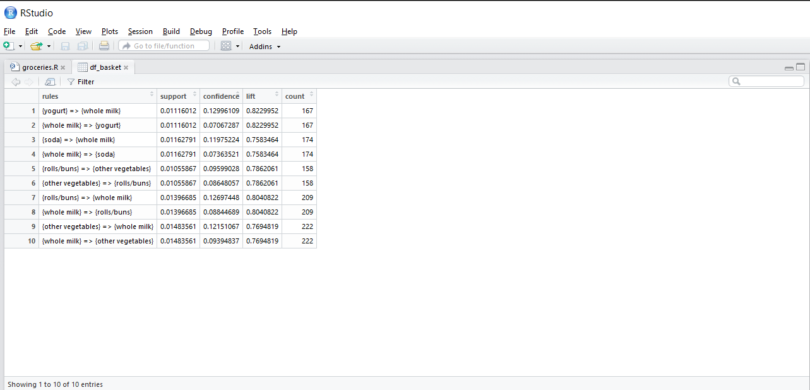
Result Dataset

Slide 4
Demo

Slide 5
Thank You

